Slide 1
Project Name
Pharmanest

Slide 2
Team Members
Dharya Mittal
Rohit Kumar Singh
Vishnukant
Hardik Talwar

Slide 3
Objective
The purpose of this Power Point Presentation is to give the requirements for our project.
It will illustrate the purpose and declaration for the development of the system.

Slide 4
Innovation
In the times of covid-19, everyone is bound to stay at home. In these tough times we need health related essentials the most.
Keeping the simple idea in mind, we came up with the idea of Pharmanest, one place to find all the health related essentials.
The website provides medicines, health monitoring devices and other products all well.
We also provide doctor consultations.

Slide 5
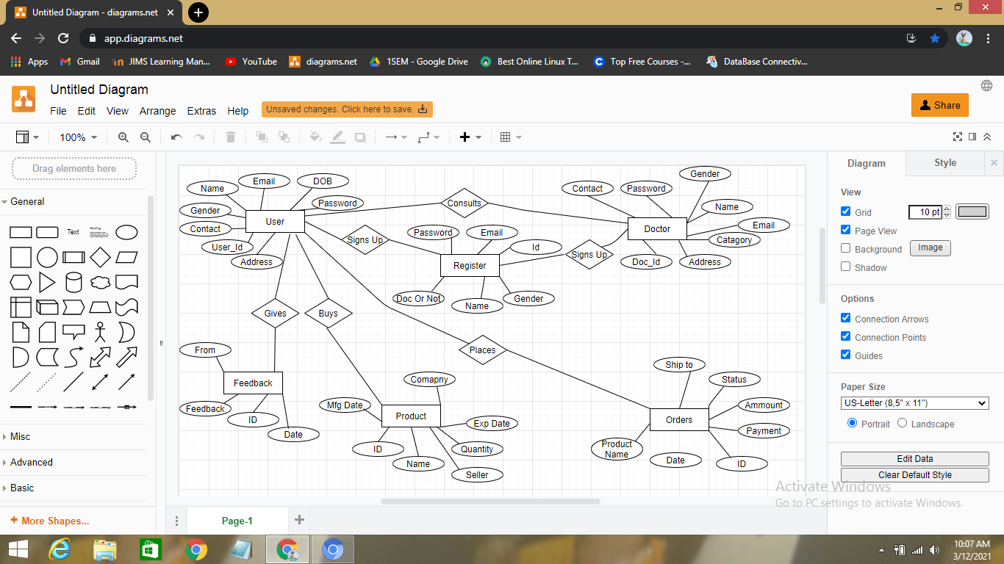
ER-Diagram

Slide 6
About The Project
Our Project, Pharmanest is based on online pharmacy. Where a Customer or Buyer or Patient can sign up to the website to buy or purchase the prescribed medicine or any available product. The
Another feature is that, a patient can contact a listed doctor. The contact between the doctor and the patient will only be possible through the means we provide. The doctor’s personal details will not be shared with the patient.

Slide 7
Operating Environment
HARDWARE SPECIFICATION :
RAM - 4.00GB
HDD - 1TB
Processor - Intel® Core i5-5200U
SOFTWARE SPECIFICATION :
Operating System - Windows 7/8/8.1/10
Front End - Bootstrap
Back End - Java

Slide 8
Modules :
Sign Up
Sign In
Cart
Search
Upload Prescription
Payment Gateway
Navigation Bar
My Account
Wallet
Orders
Help Us

Slide 9
Modules Continues….
About Us
Contact Us
Feedback

Slide 10
Tables
Sign Up\Sign In
Admin
User 1 – Costumer Or Buyer
User 2 – Doctor
Orders

Slide 11
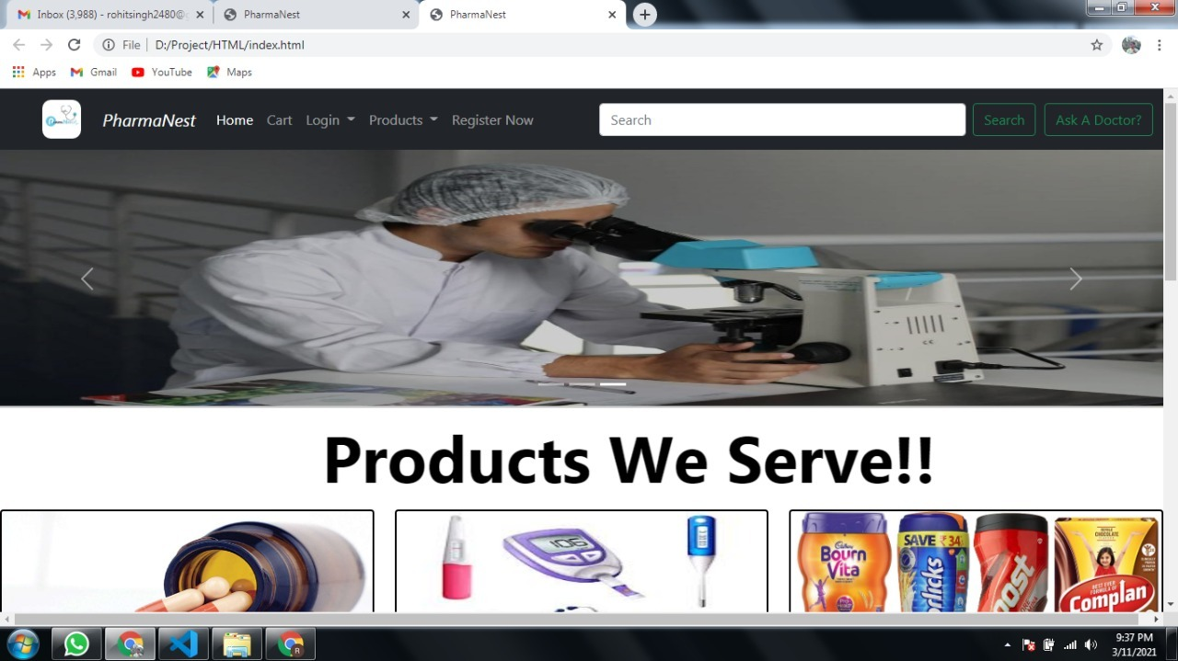
Module Screenshots

Slide 12
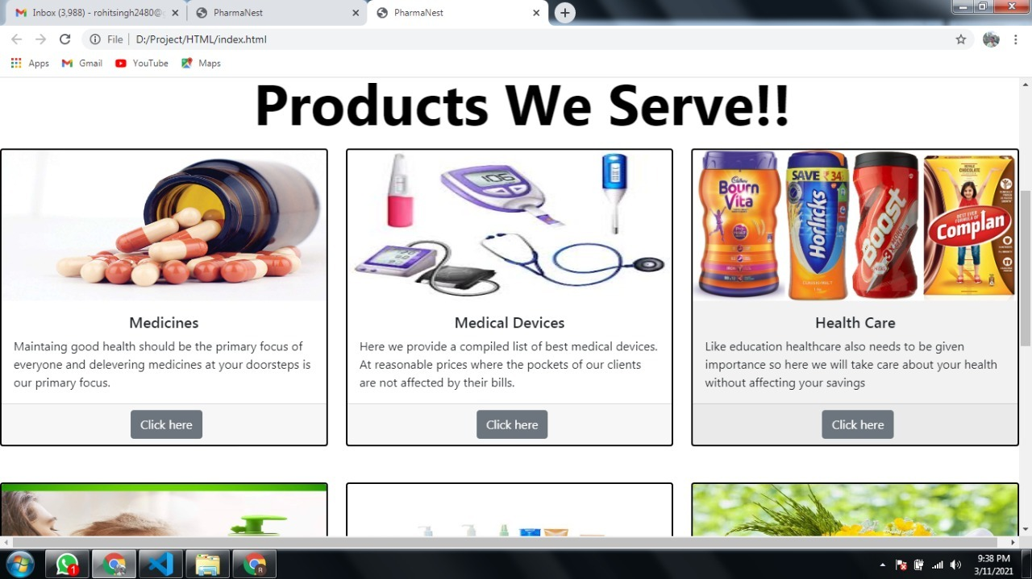

Slide 13
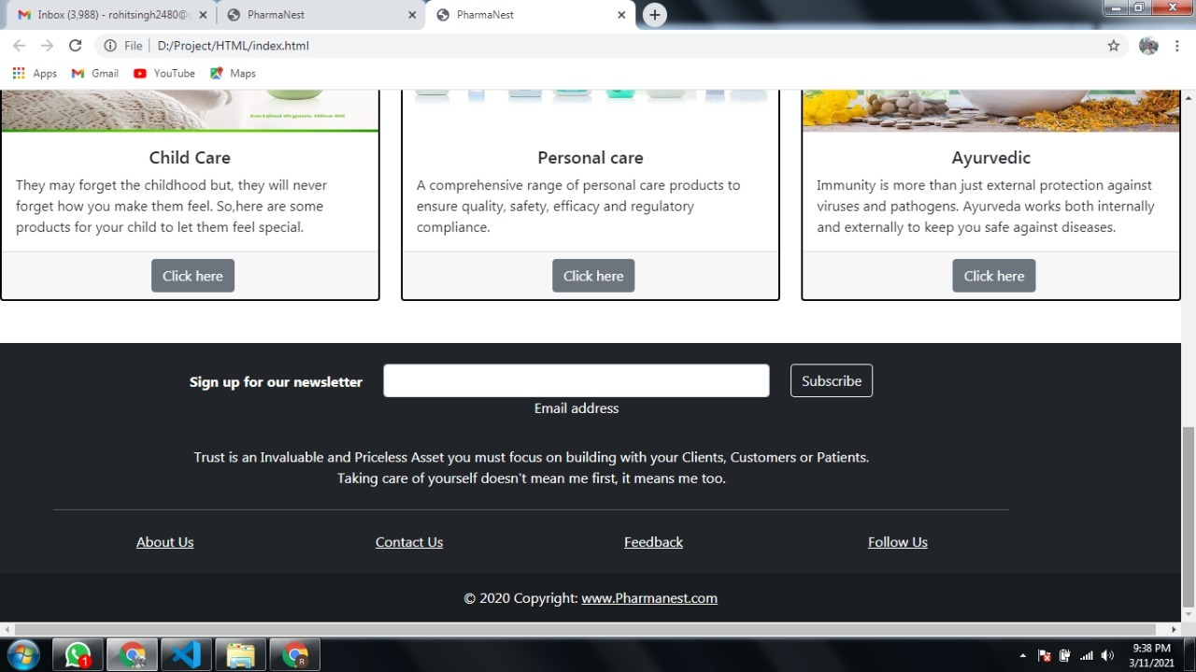

Slide 14
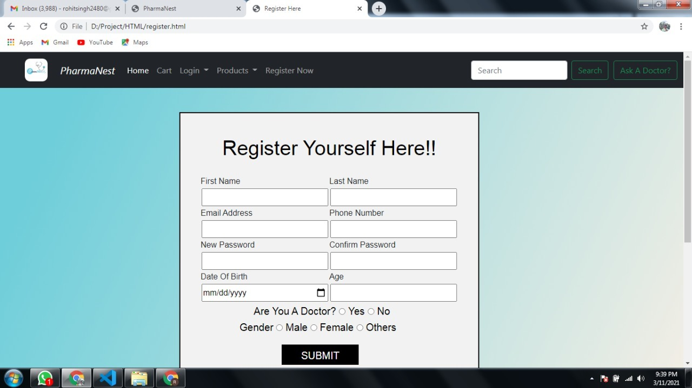

Slide 15
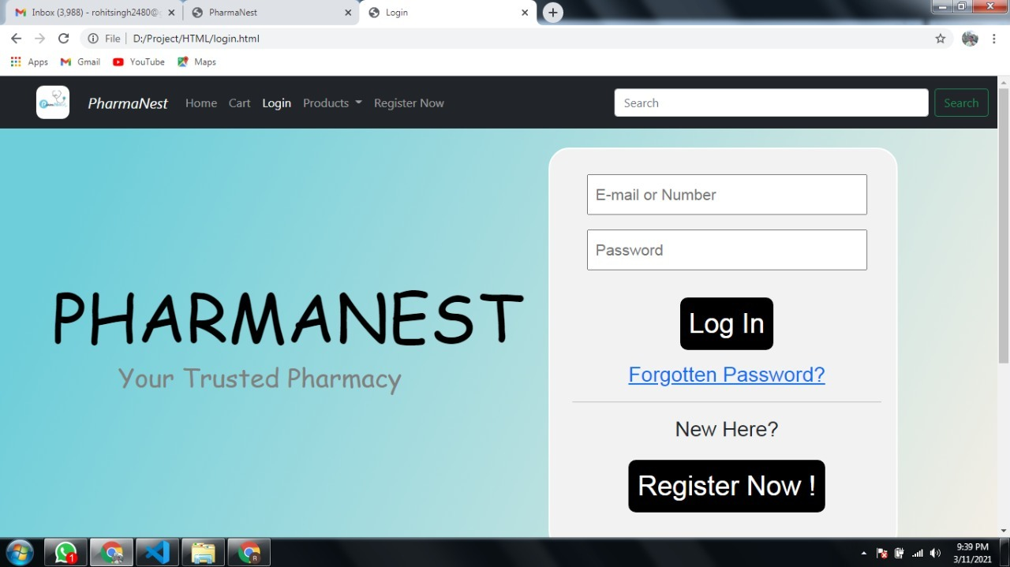

Slide 16
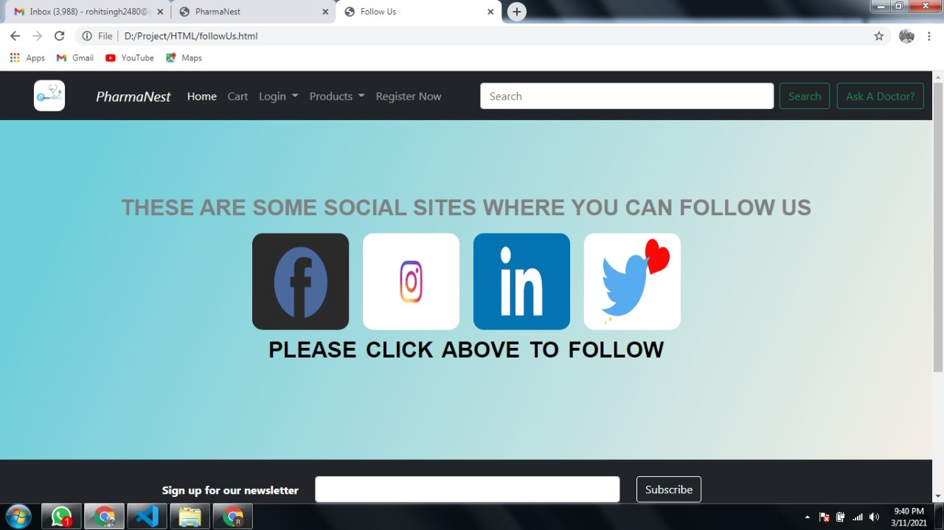

Slide 17
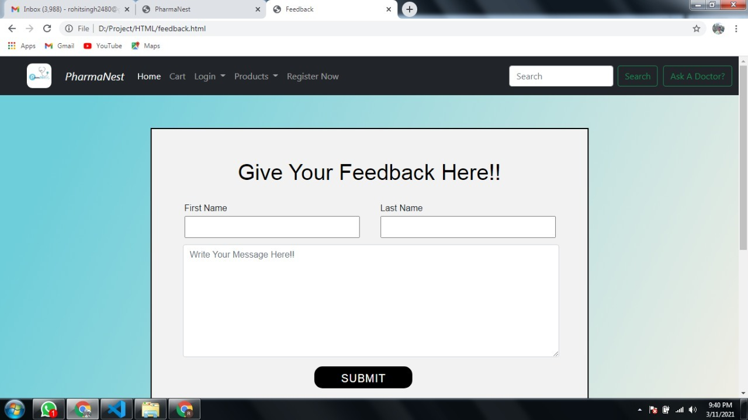

Slide 18
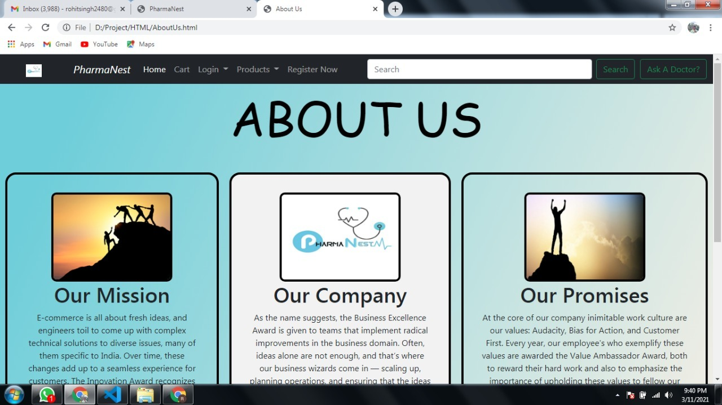

Slide 19
Team Responsibility and Contributions
Front End – Rohit Kumar Singh and Dharya Mittal
Back End- Vishnukant and Hardik Talwar

